Slide 1
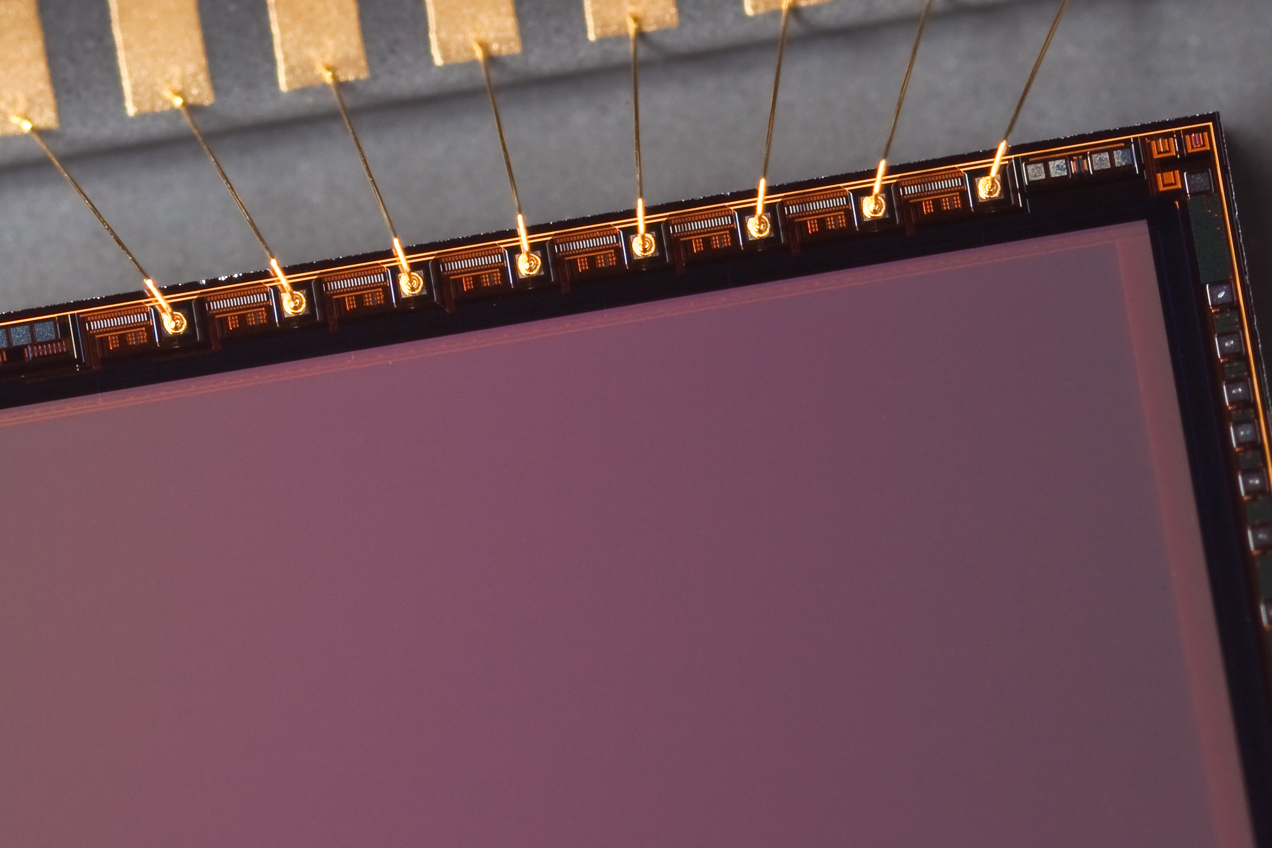
Introduction to Photography
Don Komarechka & Tim Menzies

Slide 2
Topics to Cover
How it works: Lens > Shutter > Sensor
Aperture:
  Why you want control
  F-Stop: stopping the light
  Depth of Field
Shutter Speed:
  Why you want control
  “Slow” vs. “Fast”
ISO Sensitivity
  Quantity vs. Quality
  Shooting in low light

Slide 3
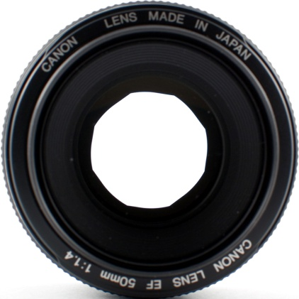
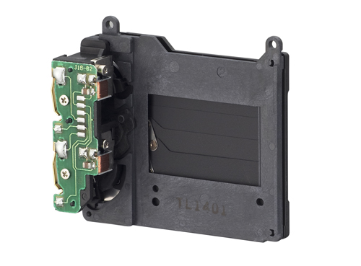
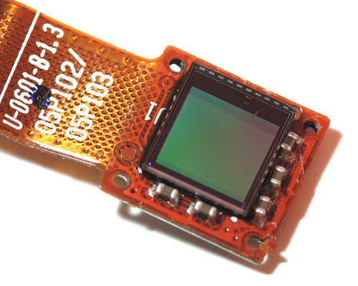
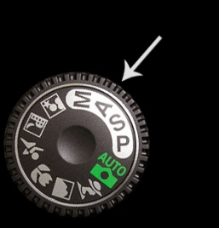
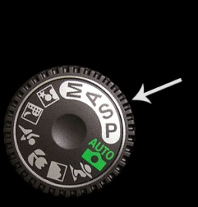
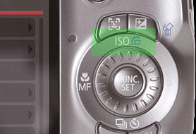
How it Works
Av S or Tv ISO

Slide 4

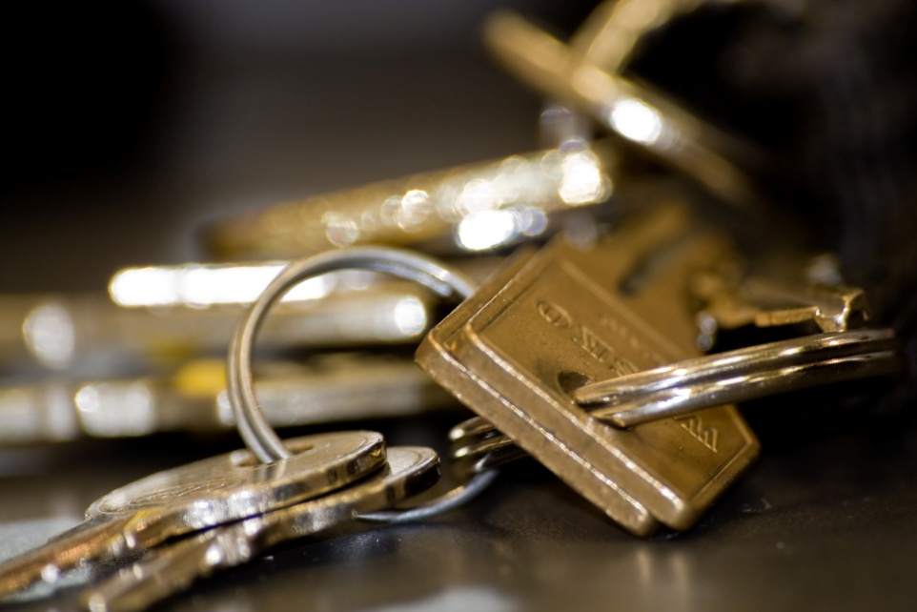
Aperture
Affects:
Amount of light at once
Depth of Field

Slide 5
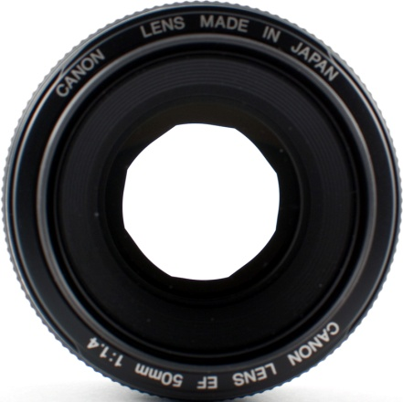
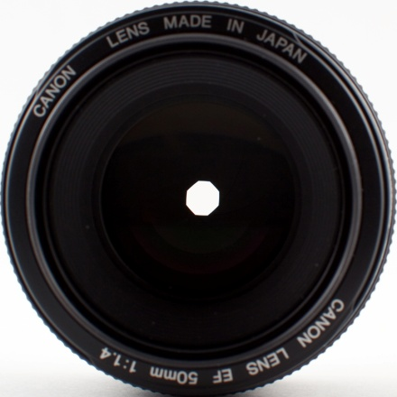
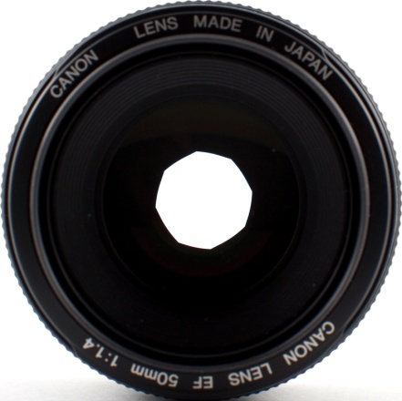
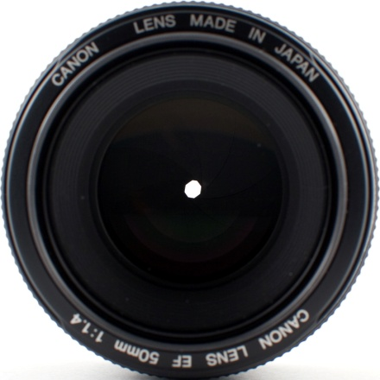
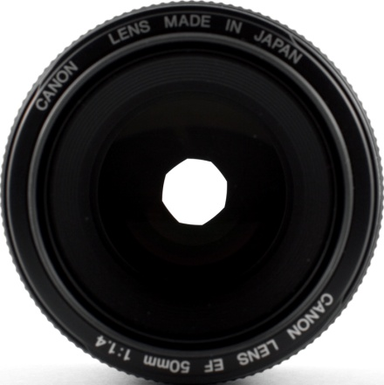
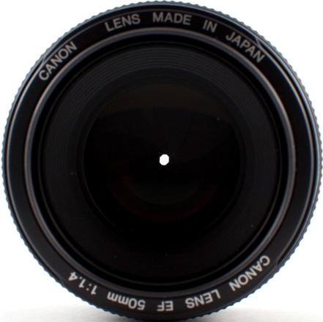
F-Stop Examples
F/1.8
F/8
F/2.8
F/16
F/4
F/22

Slide 6
F-Stop and Depth of Field

Slide 7
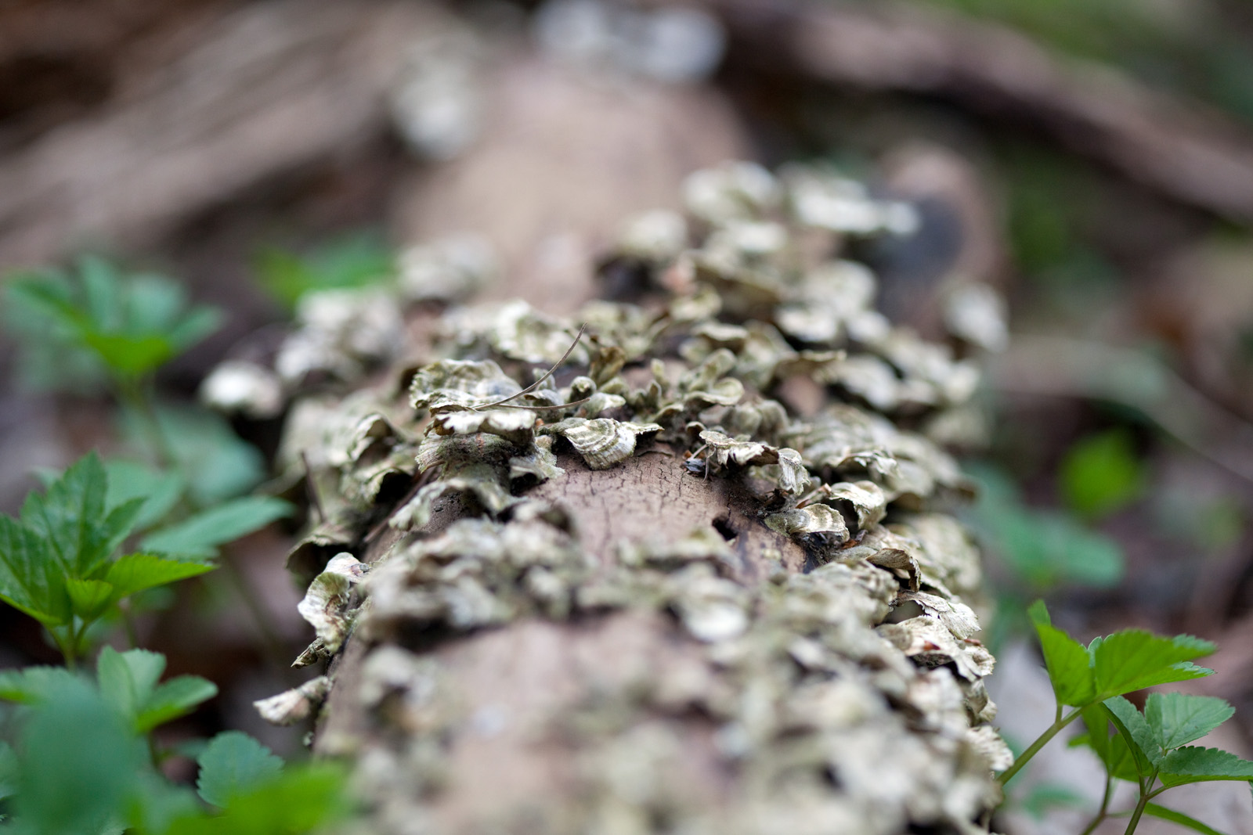
F/2.8 1/800 sec ISO 800

Slide 8
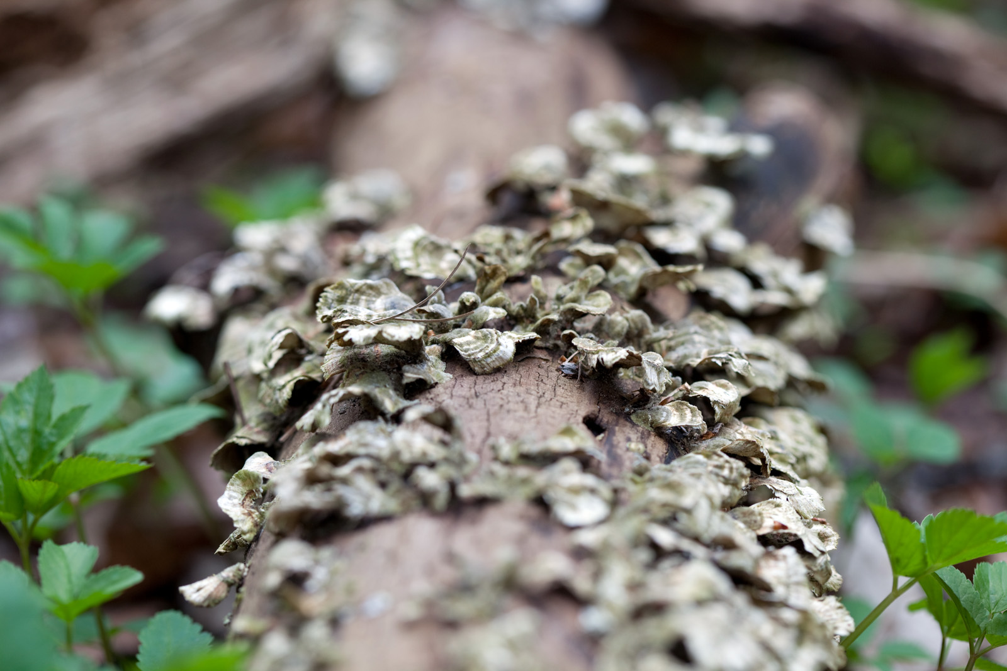
F/4.5 1/100 sec ISO 200

Slide 9
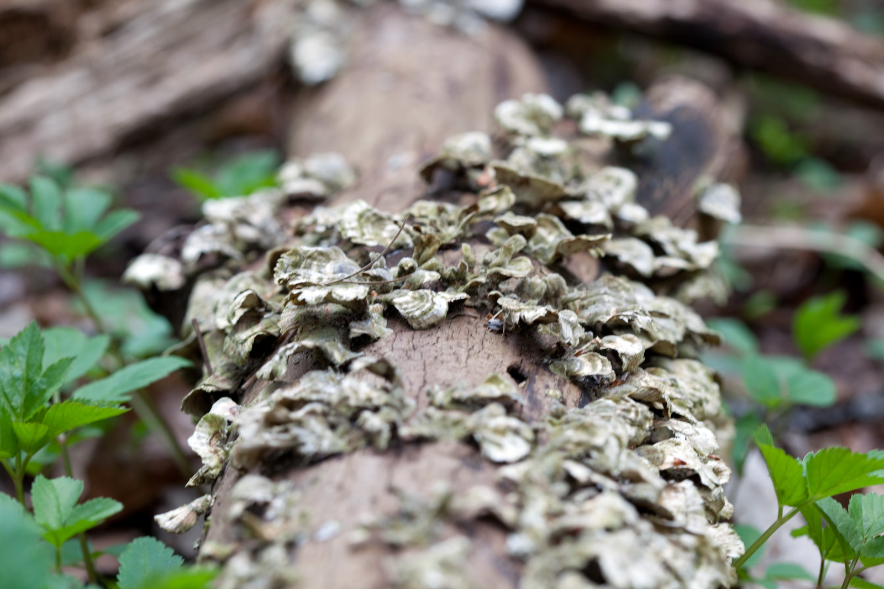
F/6.3 1/50 sec ISO 200

Slide 10
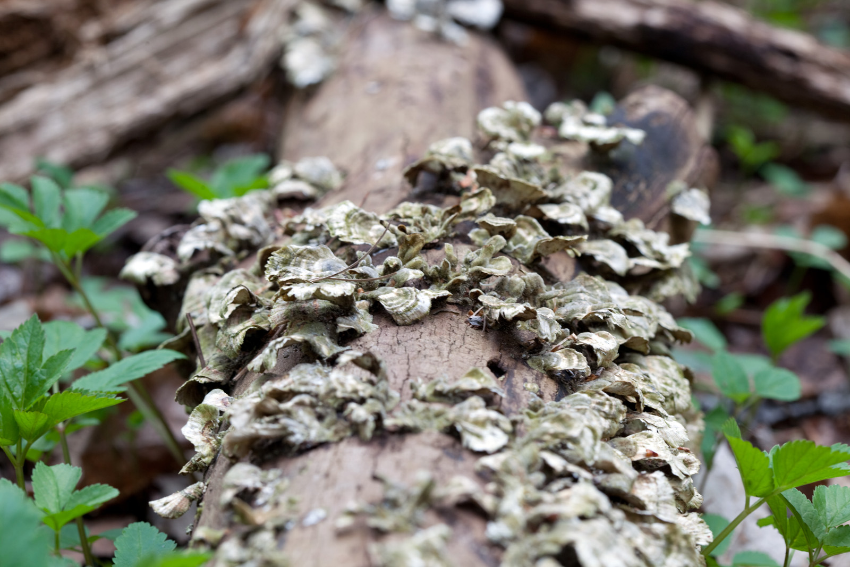
F/9 1/25 sec ISO 200

Slide 11
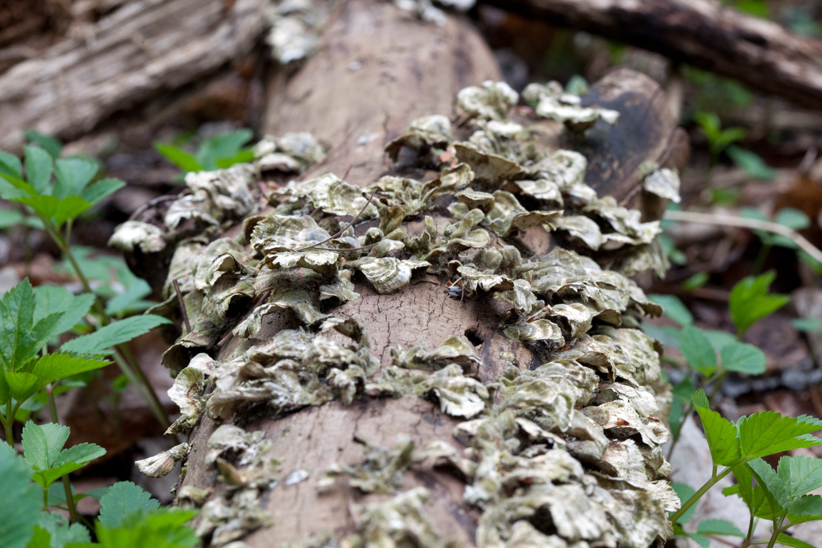
F/13 1/50 sec ISO 800

Slide 12
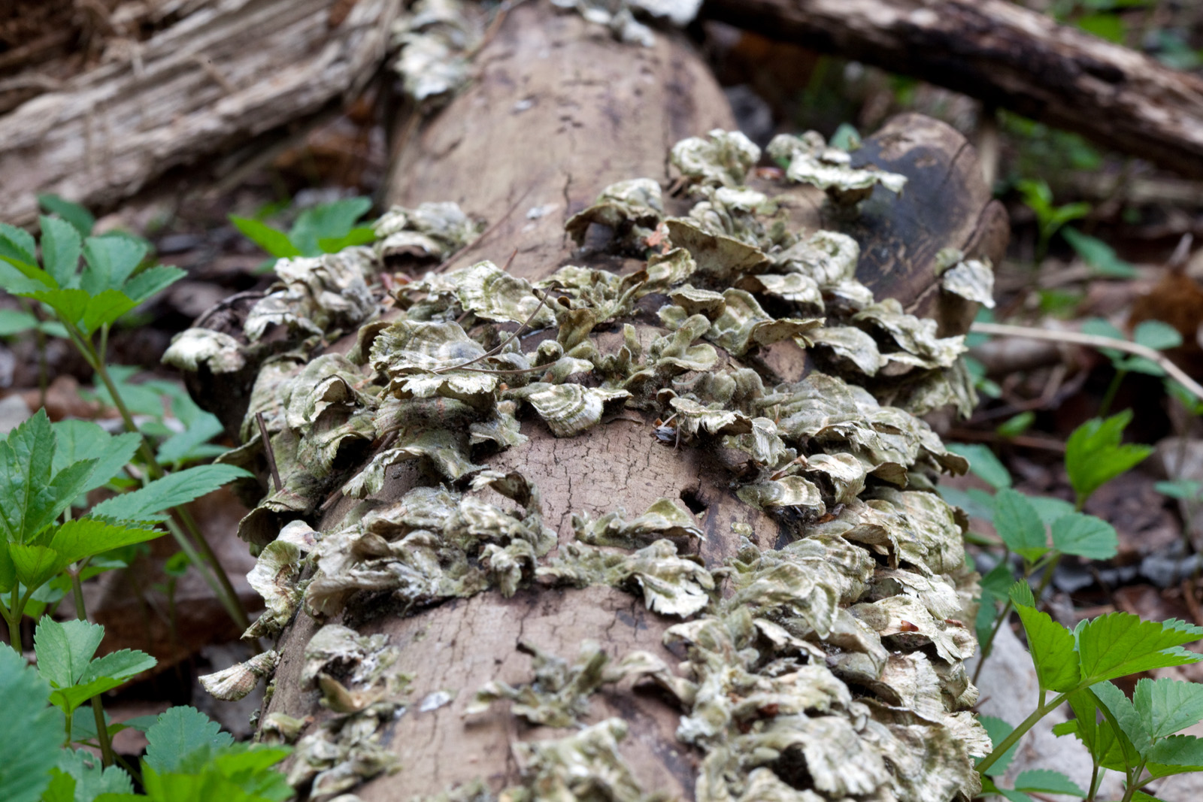
F/18 1/25 sec ISO 800

Slide 13
F/2.8 1/800 sec ISO 800

Slide 14
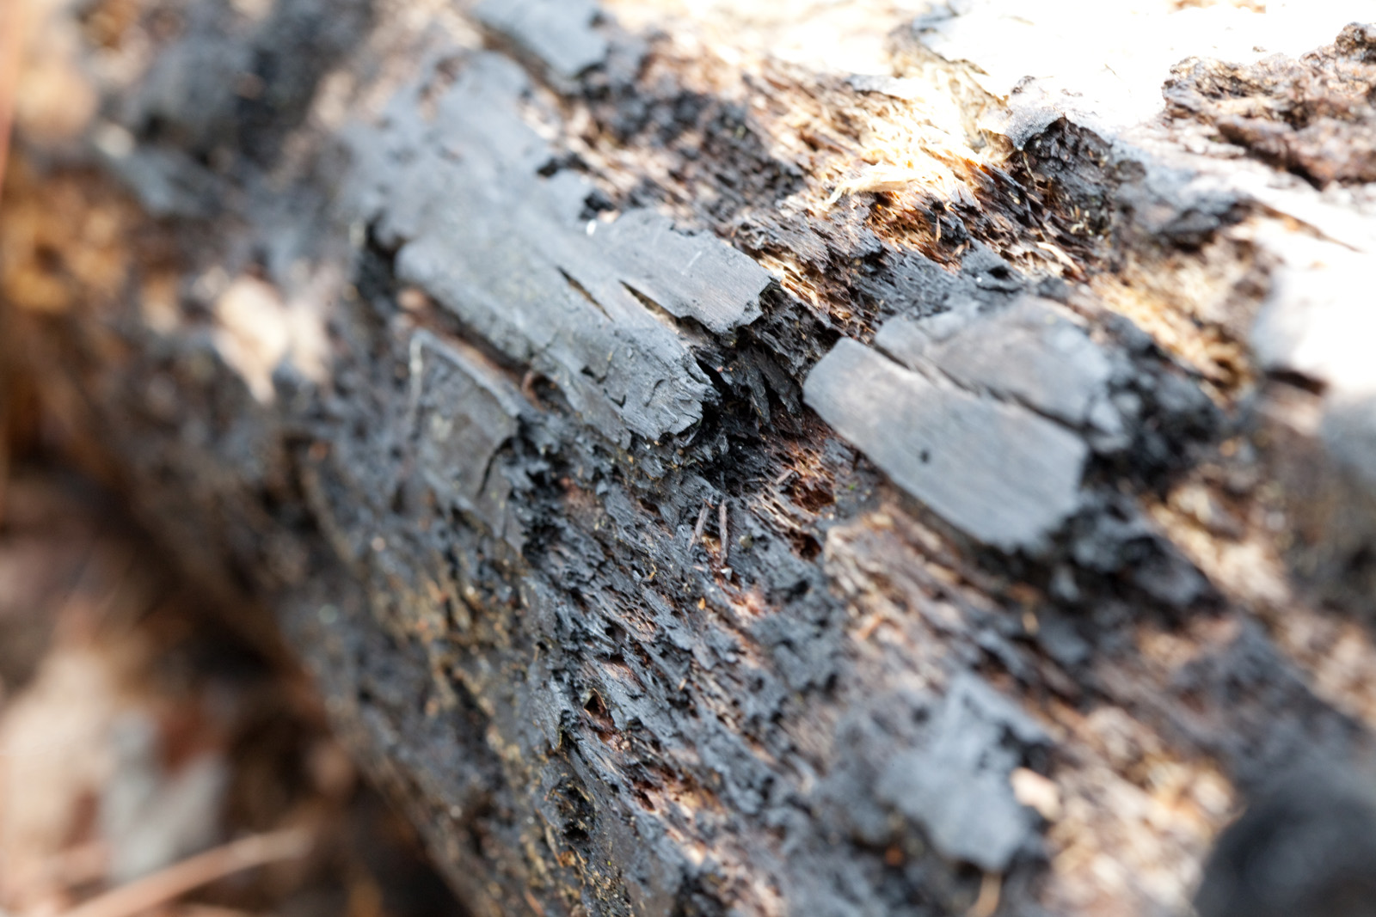
F/10 1/25 sec ISO 800

Slide 15
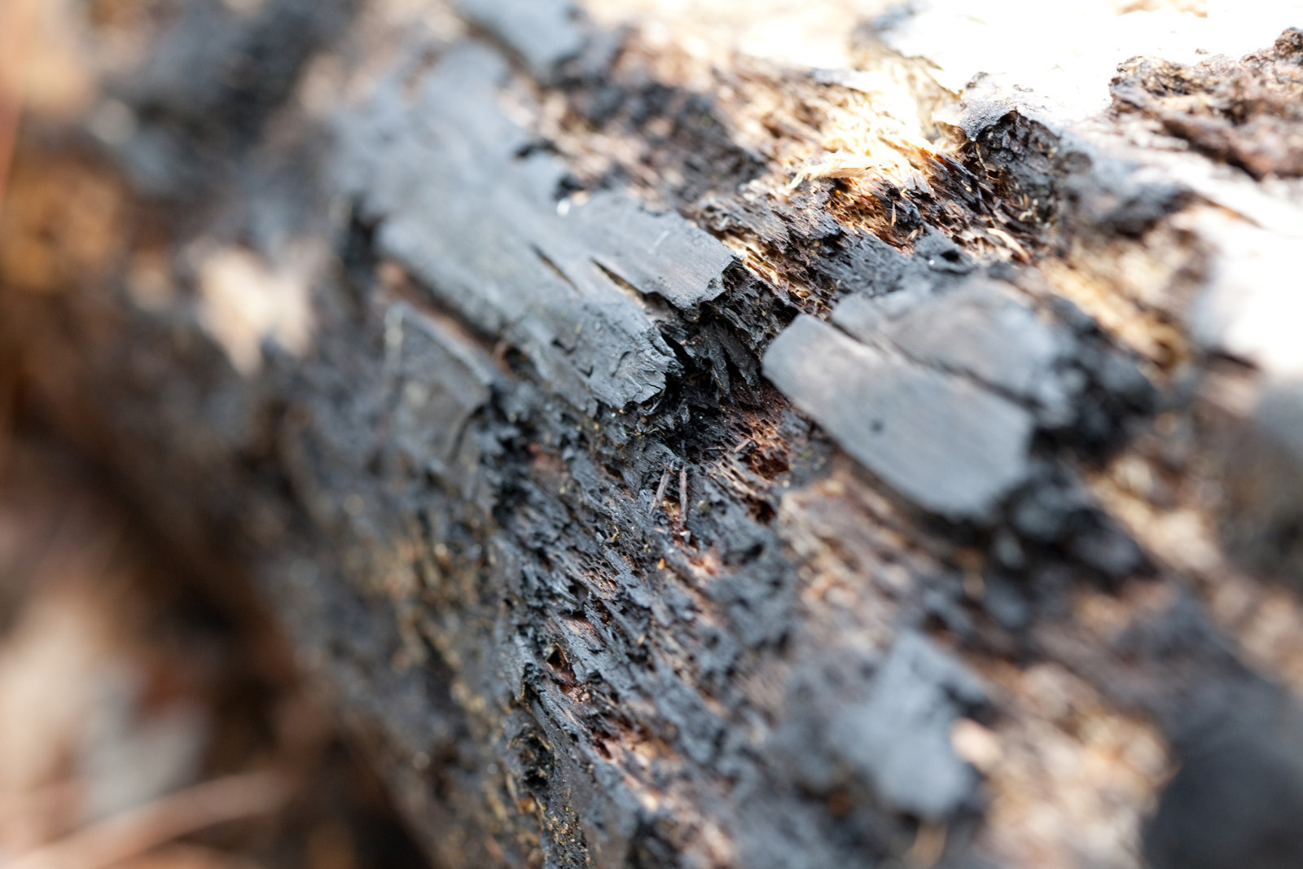
F/6.3 1/60 sec ISO 800

Slide 16
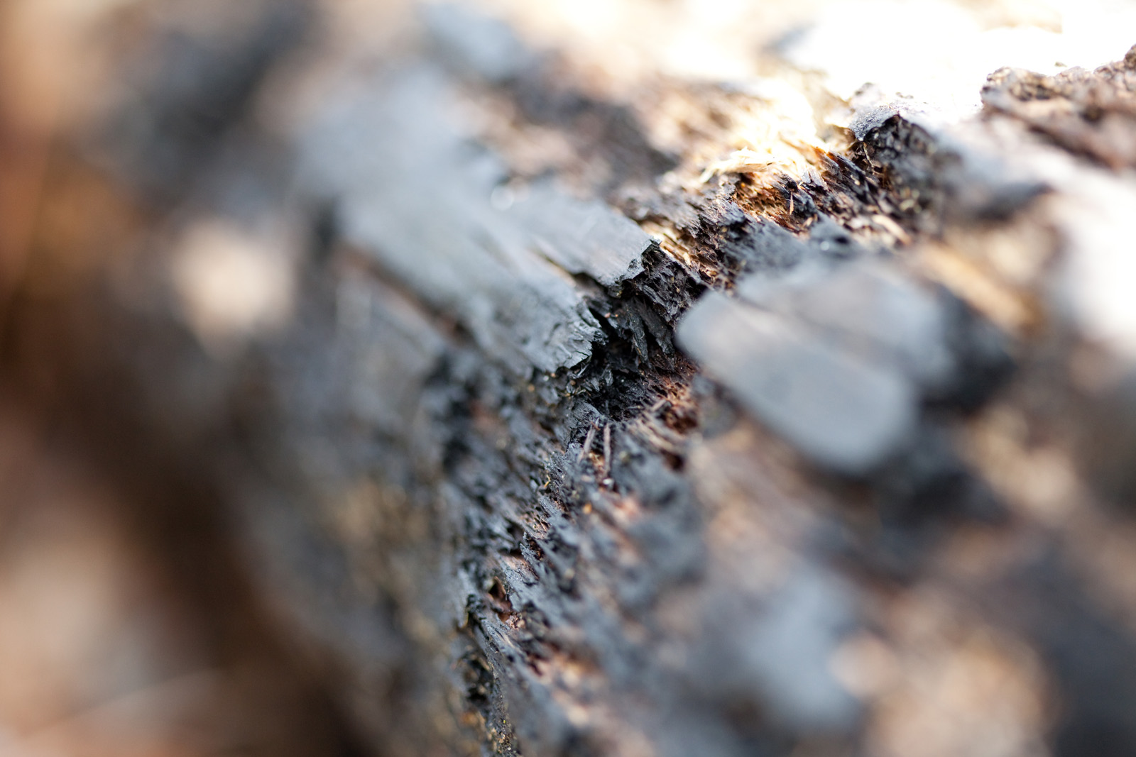
F/2.8 1/320 sec ISO 800

Slide 17
F/10 1/25 sec ISO 800

Slide 18
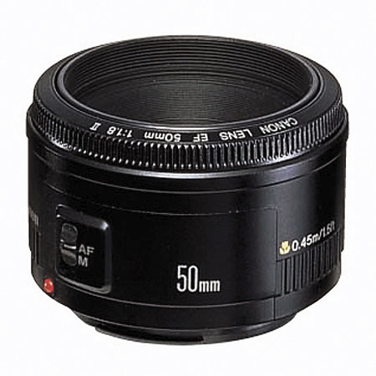
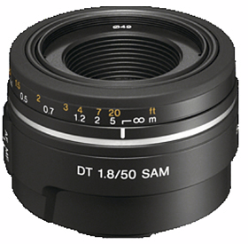
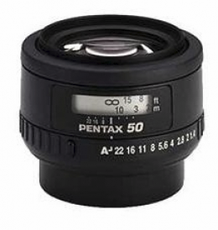
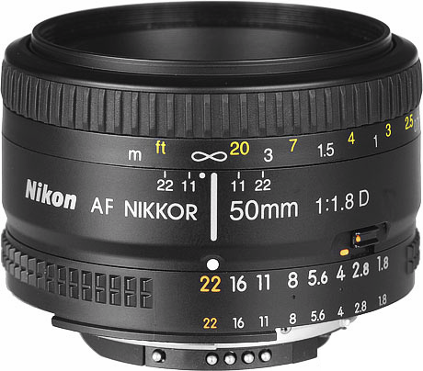
50mm – the Cheapest, Fastest Lens
Canon Nikon Sony / Minolta Pentax

Slide 19
Using Depth of Field to See Through Obstacles

Slide 20
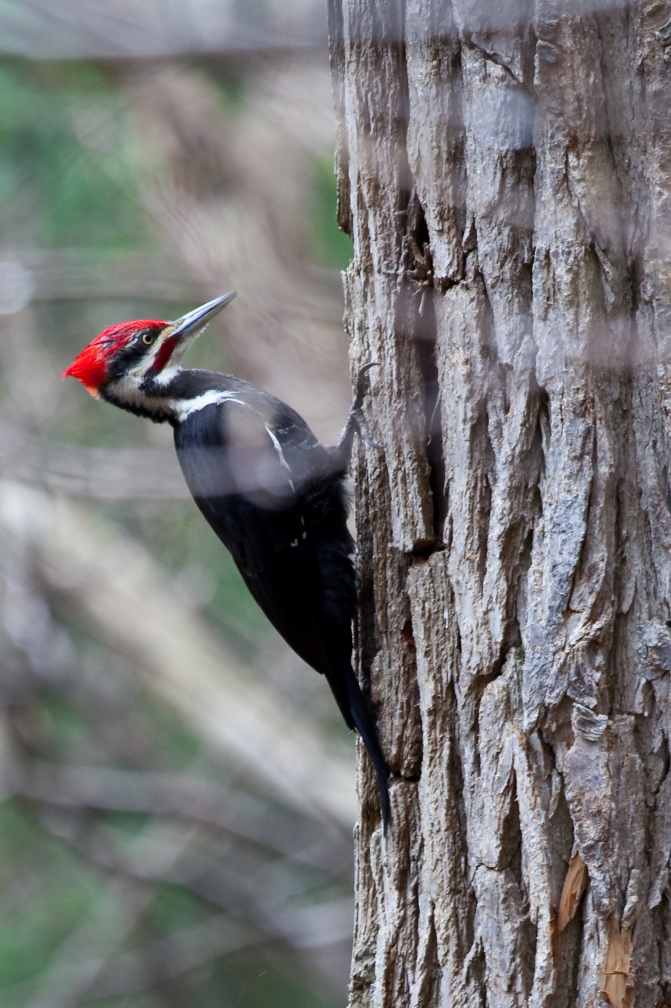
Shallow Depth of Field lets you see through branches

Slide 21
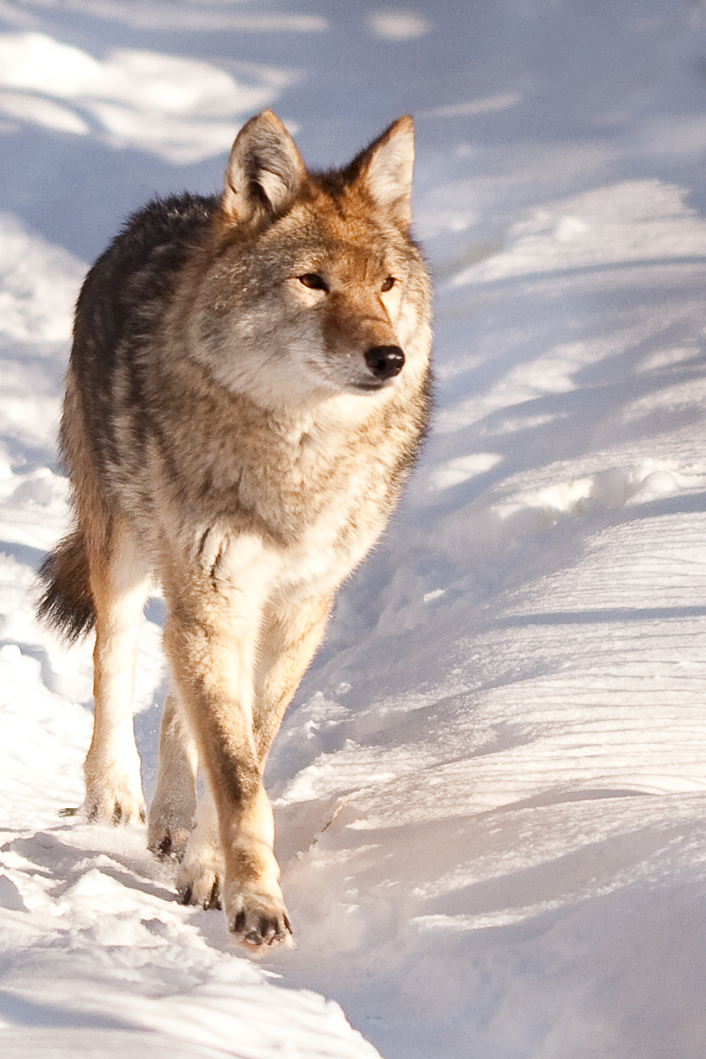
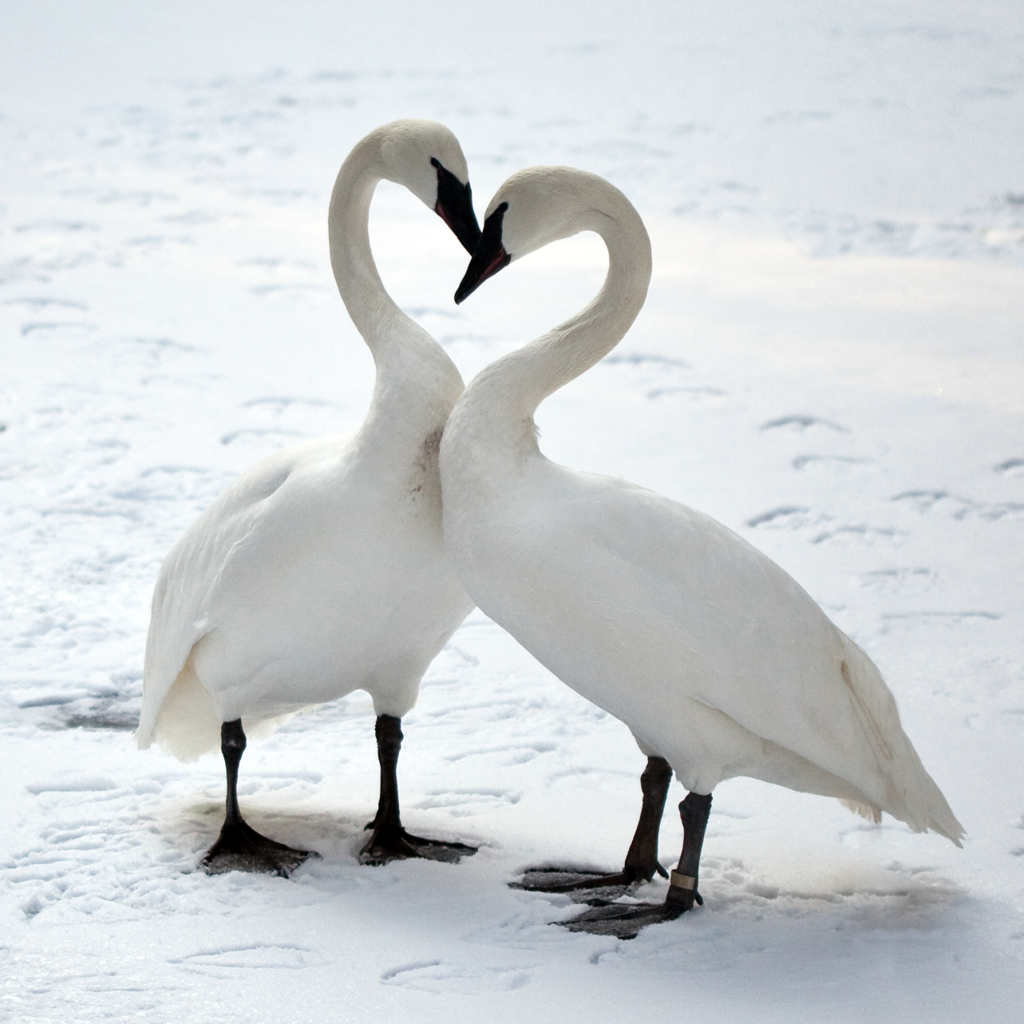
And through rope or chain-link fences, too.
F/2.8

Slide 22
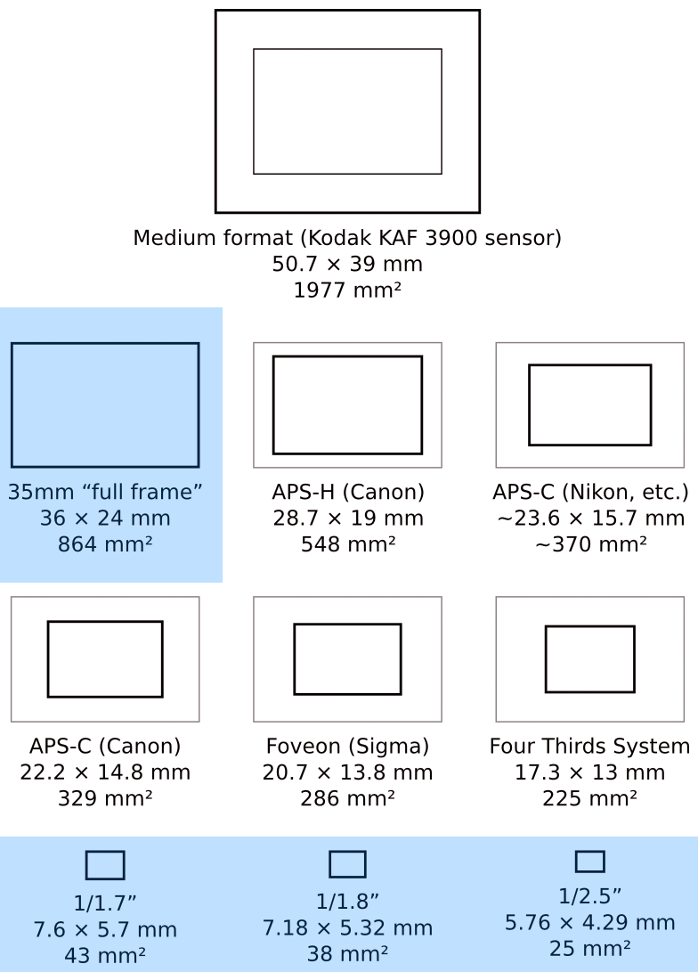
Full Frame SLR vs. Point & Shoot

Slide 23

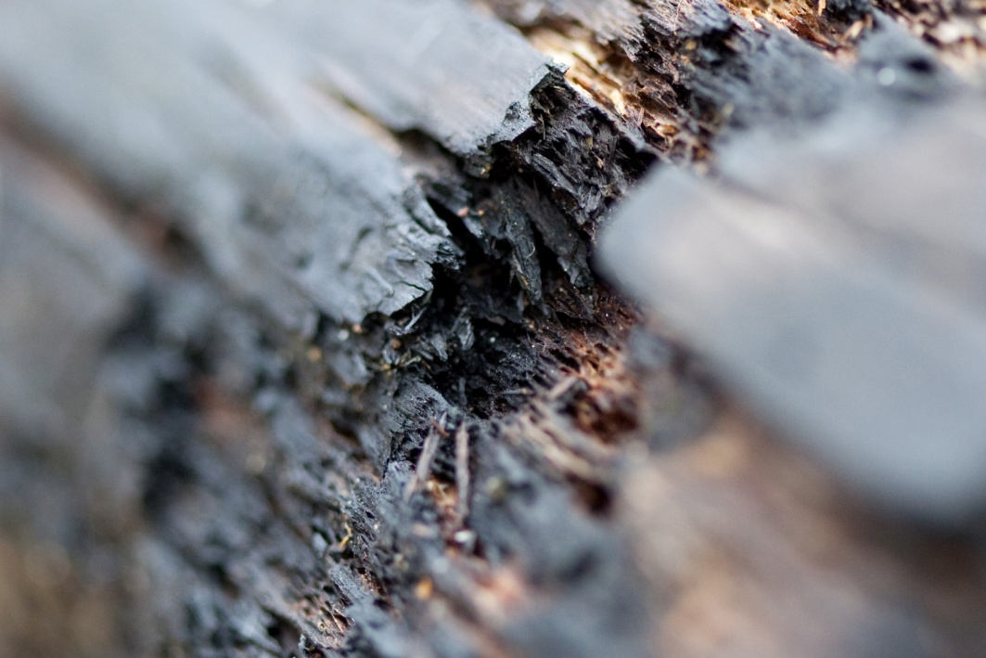

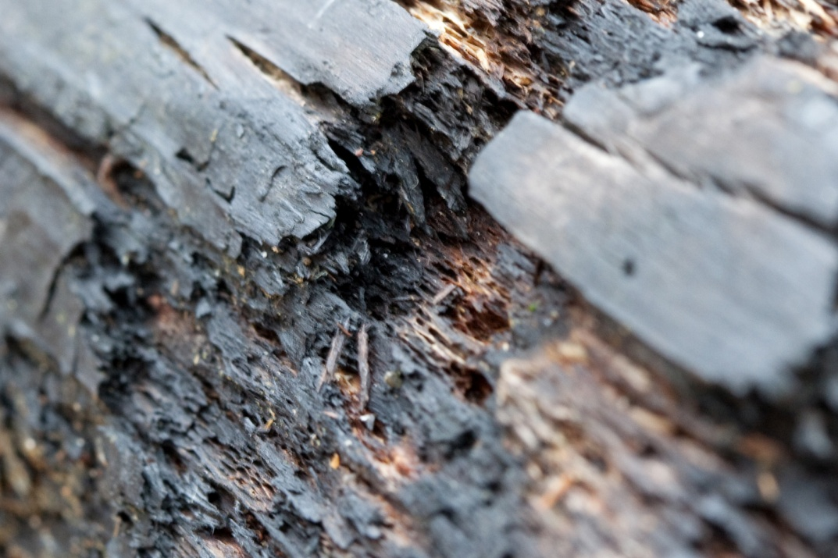
Full Frame SLR vs. Point & Shoot

Slide 24
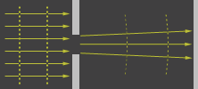
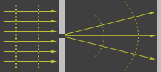

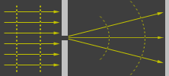
Diffraction Limiting
Image Source: Cambridge In Colour
http://www.cambridgeincolour.com/

Slide 25
Shutter Speed
Affects:
Motion blur
“Camera shake”
1/2000 sec – to – 30 sec

Slide 26
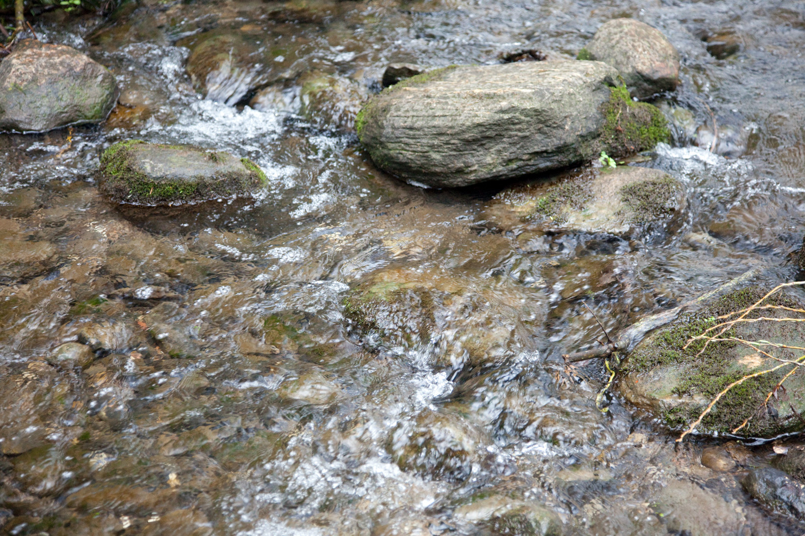
F/4 1/200 sec ISO 3200

Slide 27
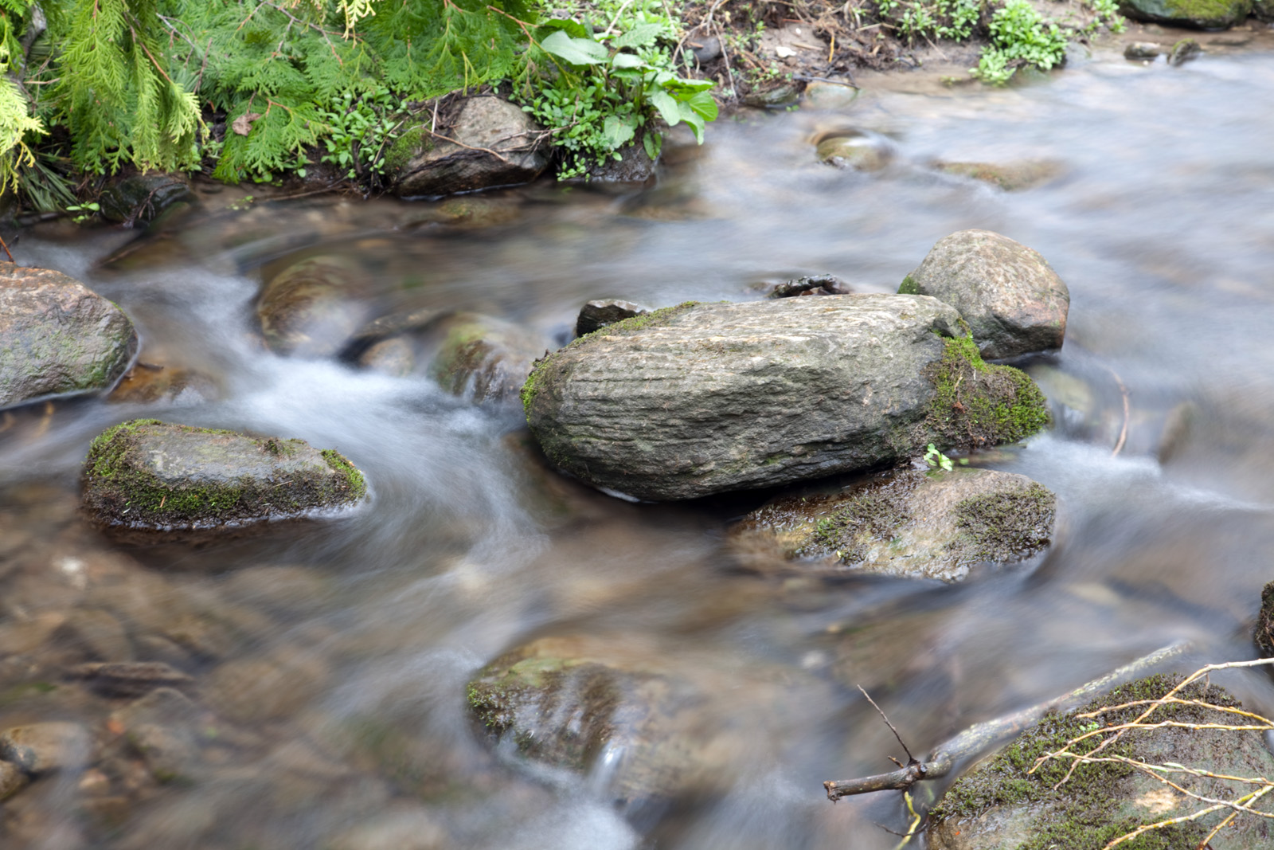
F/10 2 sec ISO 50

Slide 28
F/4 1/200 sec ISO 3200

Slide 29
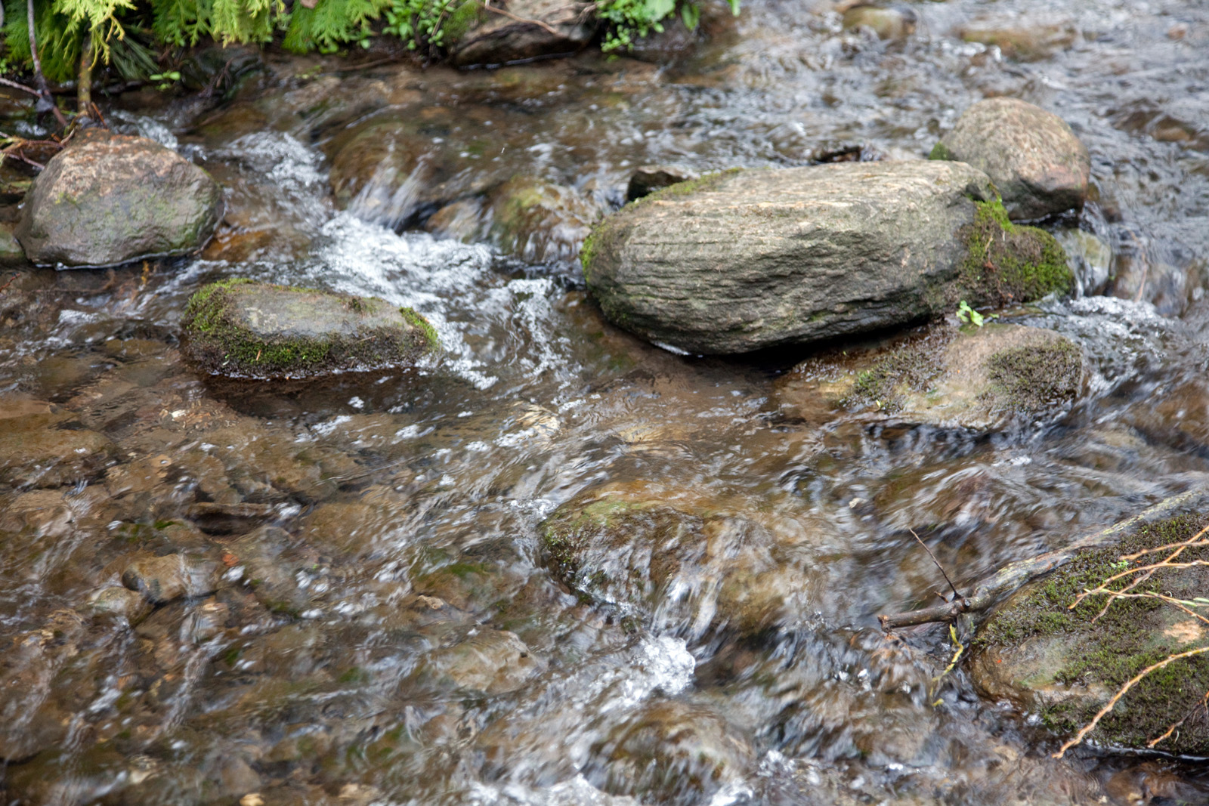
F/4 1/100 sec ISO 1600

Slide 30
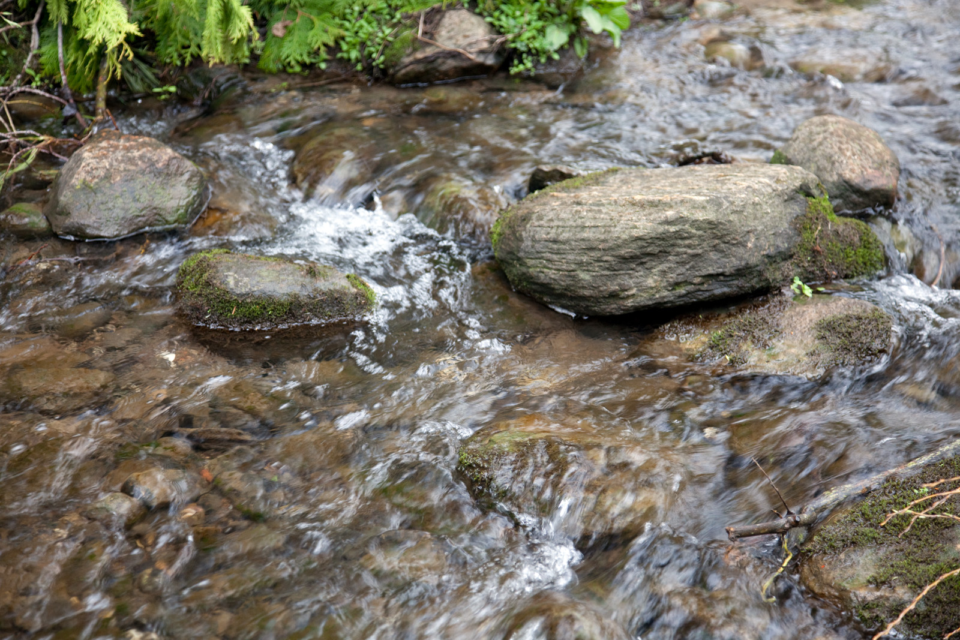
F/4 1/60 sec ISO 1000

Slide 31
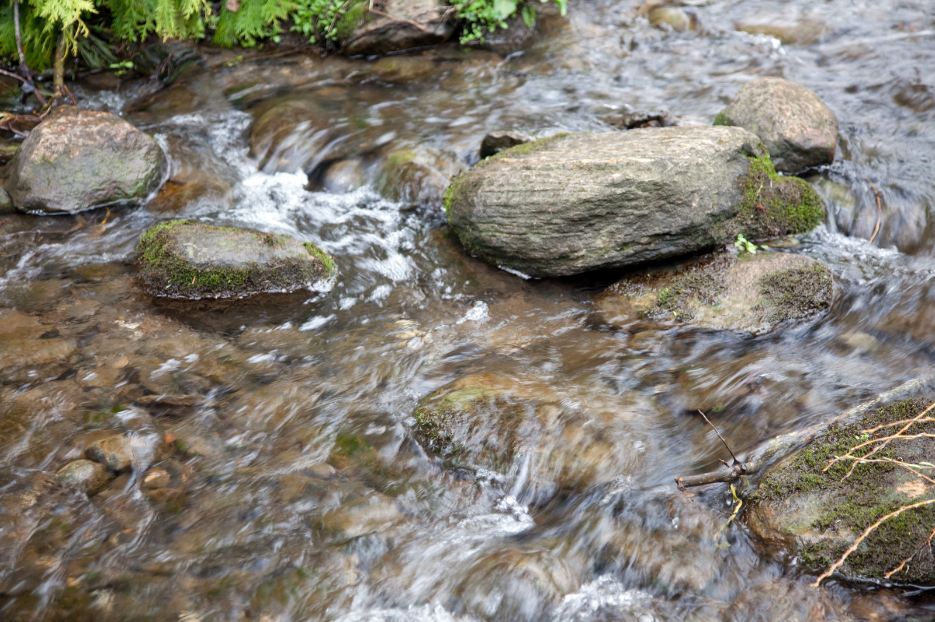
F/4 1/40 sec ISO 800

Slide 32
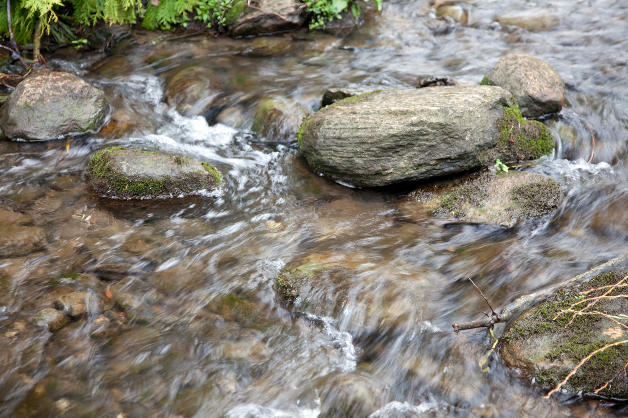
F/4 1/25 sec ISO 500

Slide 33
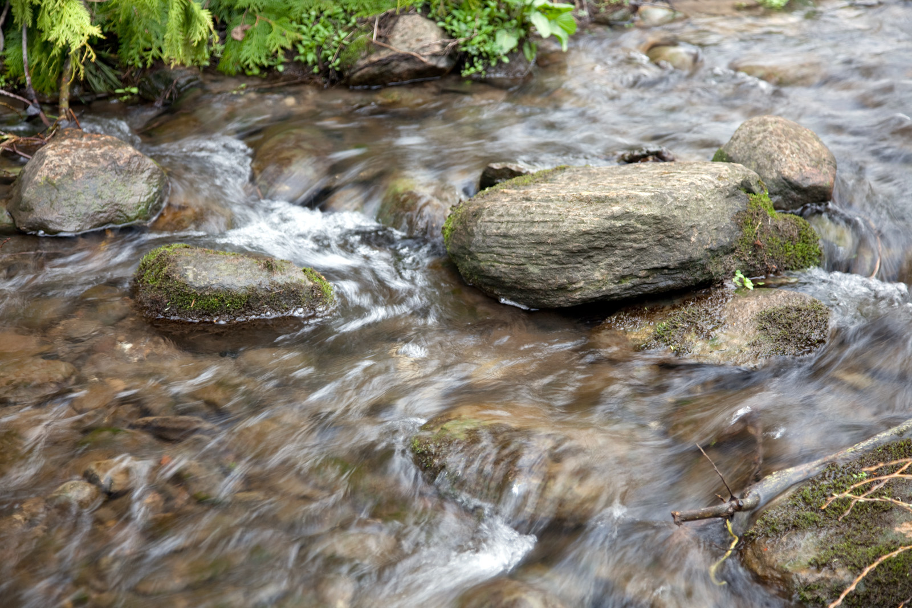
F/4 1/15 sec ISO 250

Slide 34
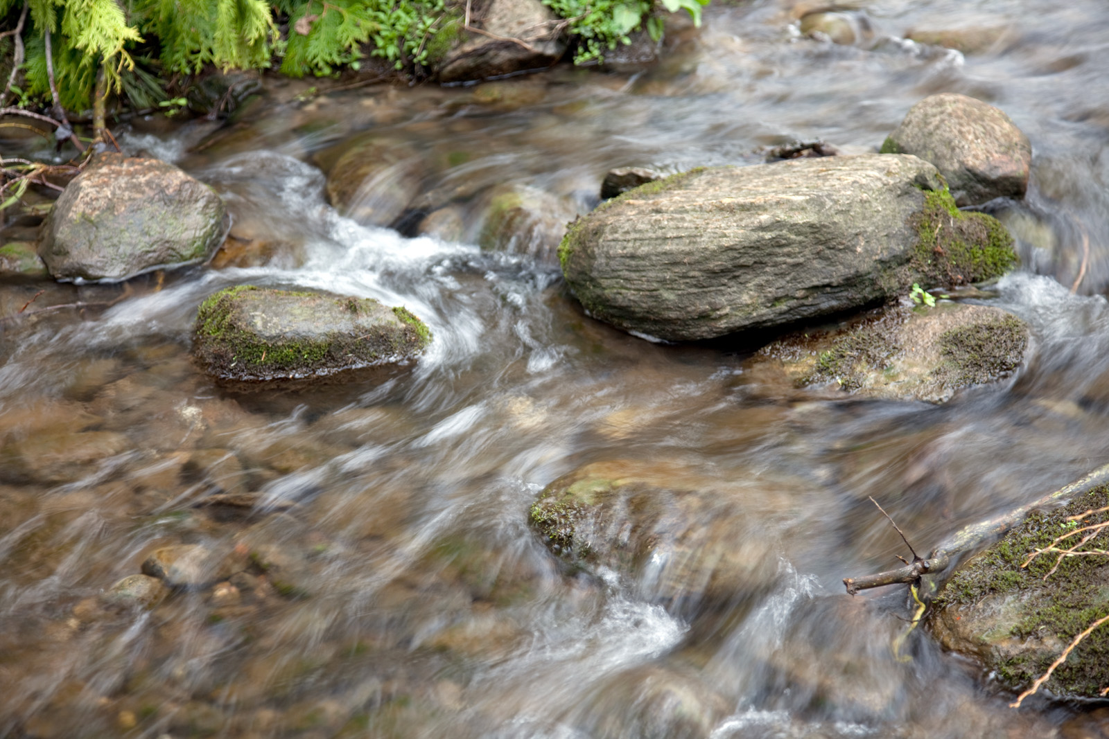
F/4 1/8 sec ISO 100

Slide 35
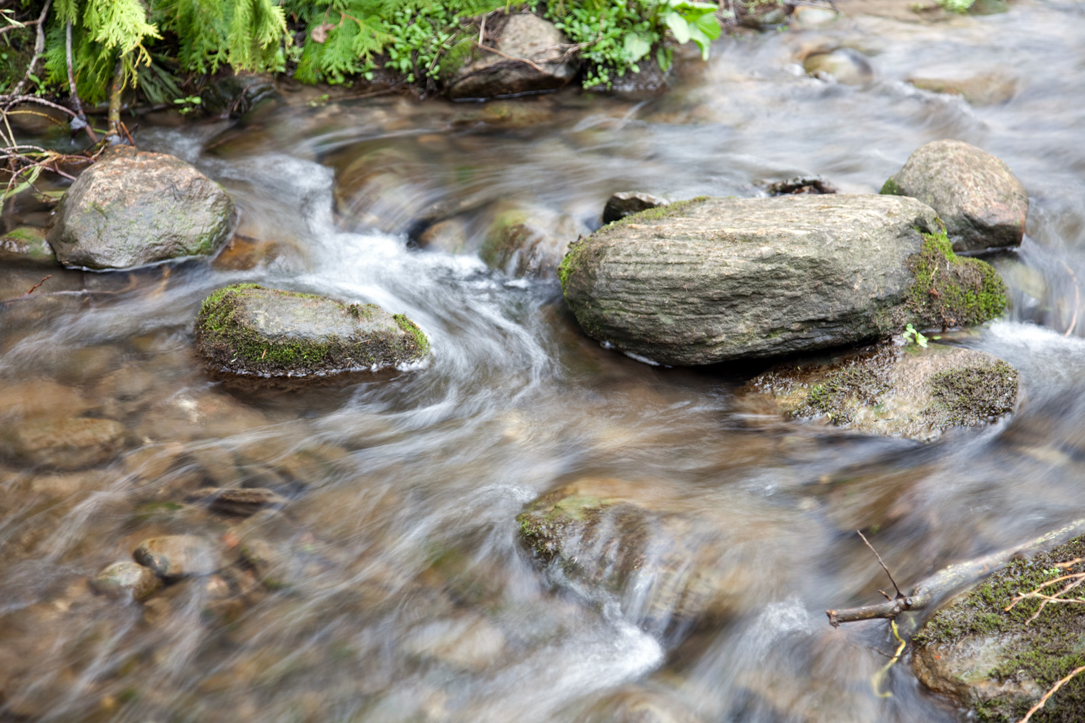
F/4.5 1/4 sec ISO 100

Slide 36
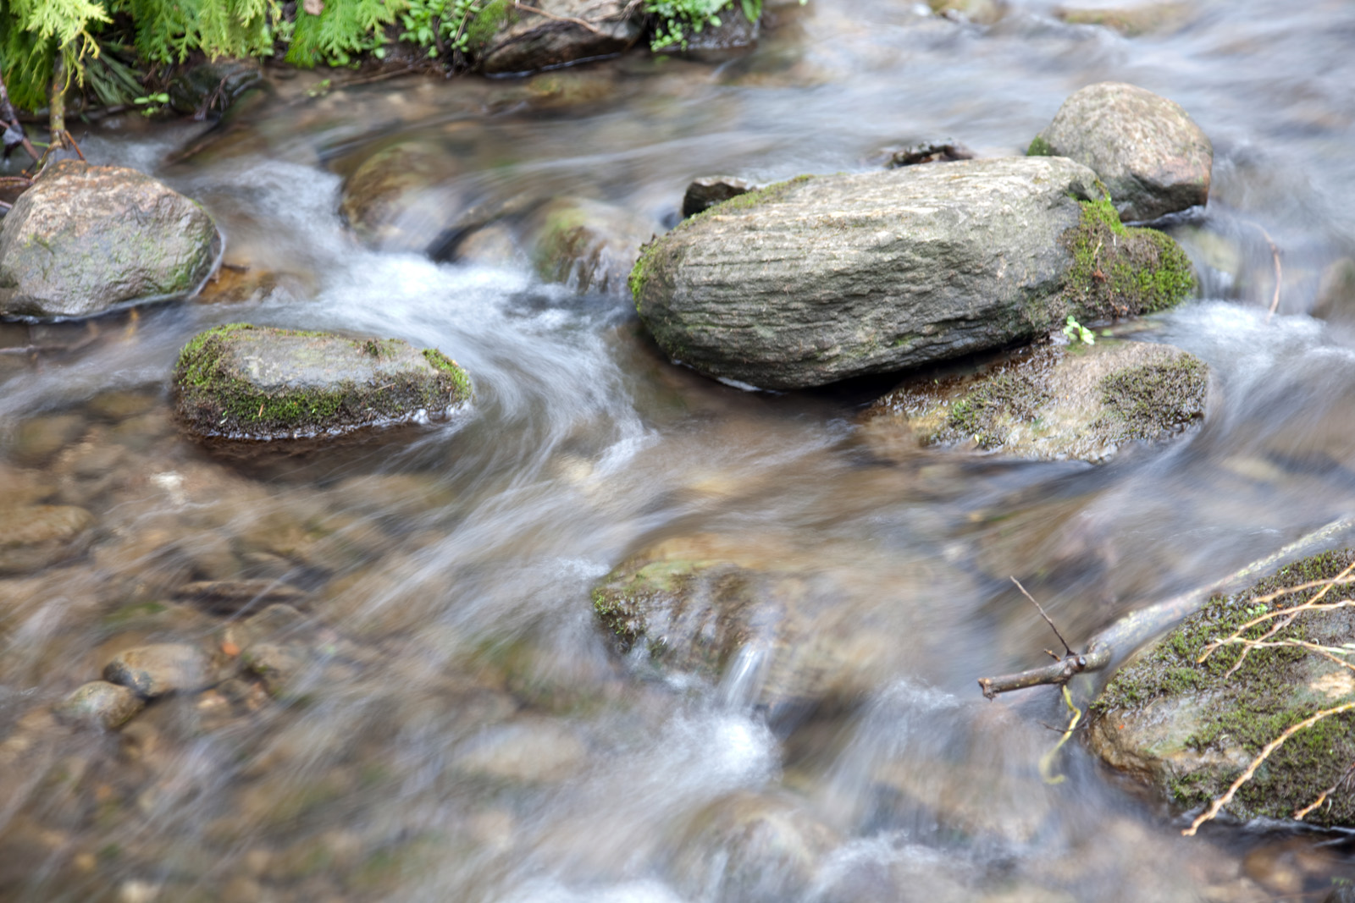
F/4.5 1/2 sec ISO 50

Slide 37
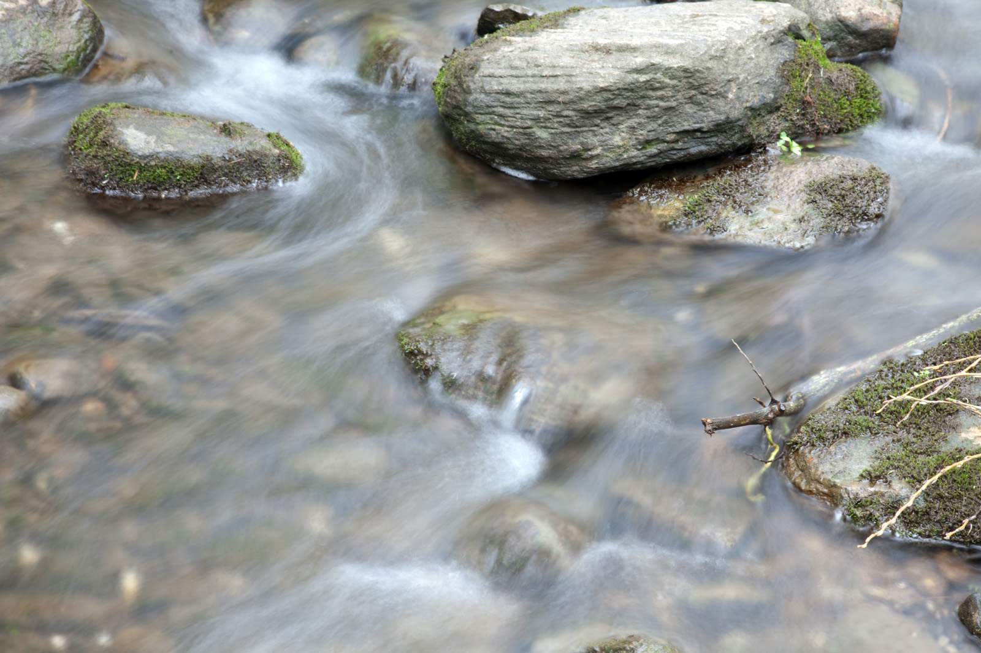
F/14 1 sec ISO 50

Slide 38
F/10 2 sec ISO 50

Slide 39
Further Examples

Slide 40
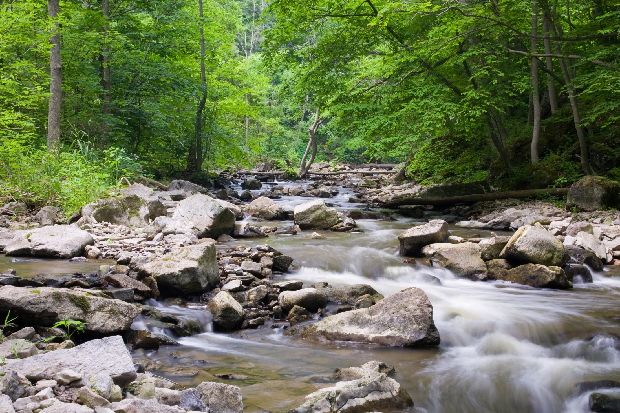
F/16 1 sec ISO 100

Slide 41
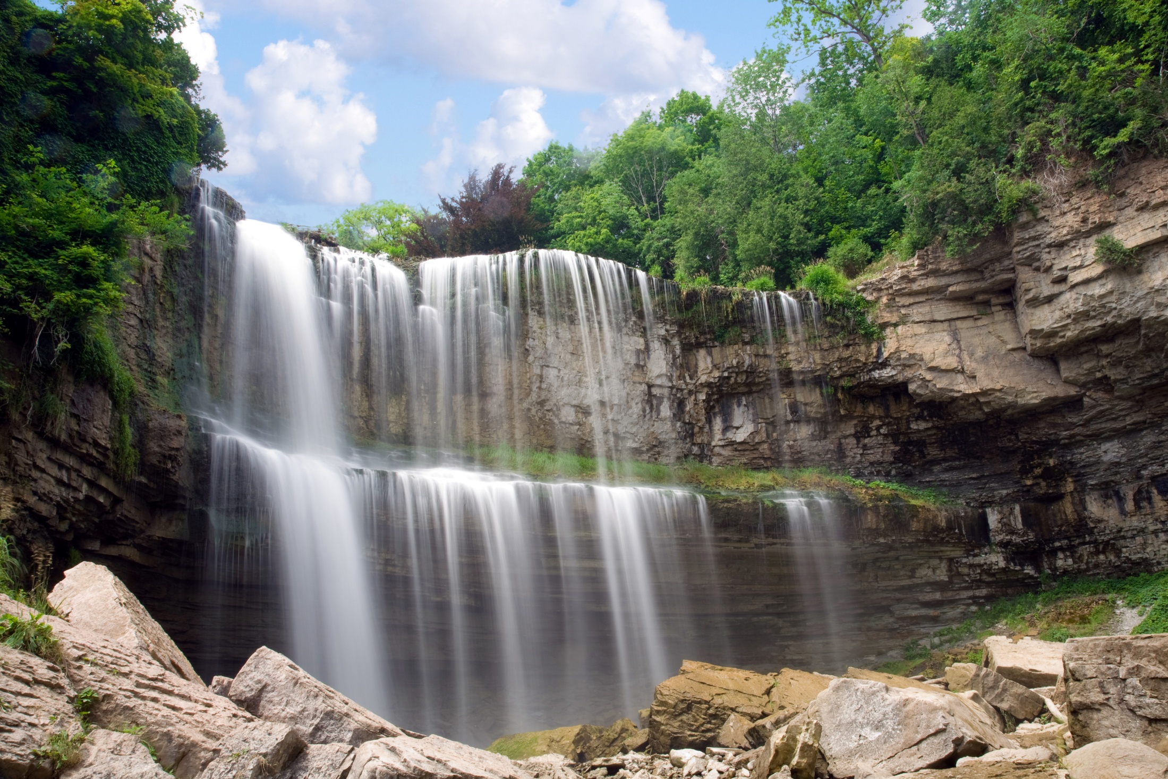
F/22 1 sec ISO 50

Slide 42
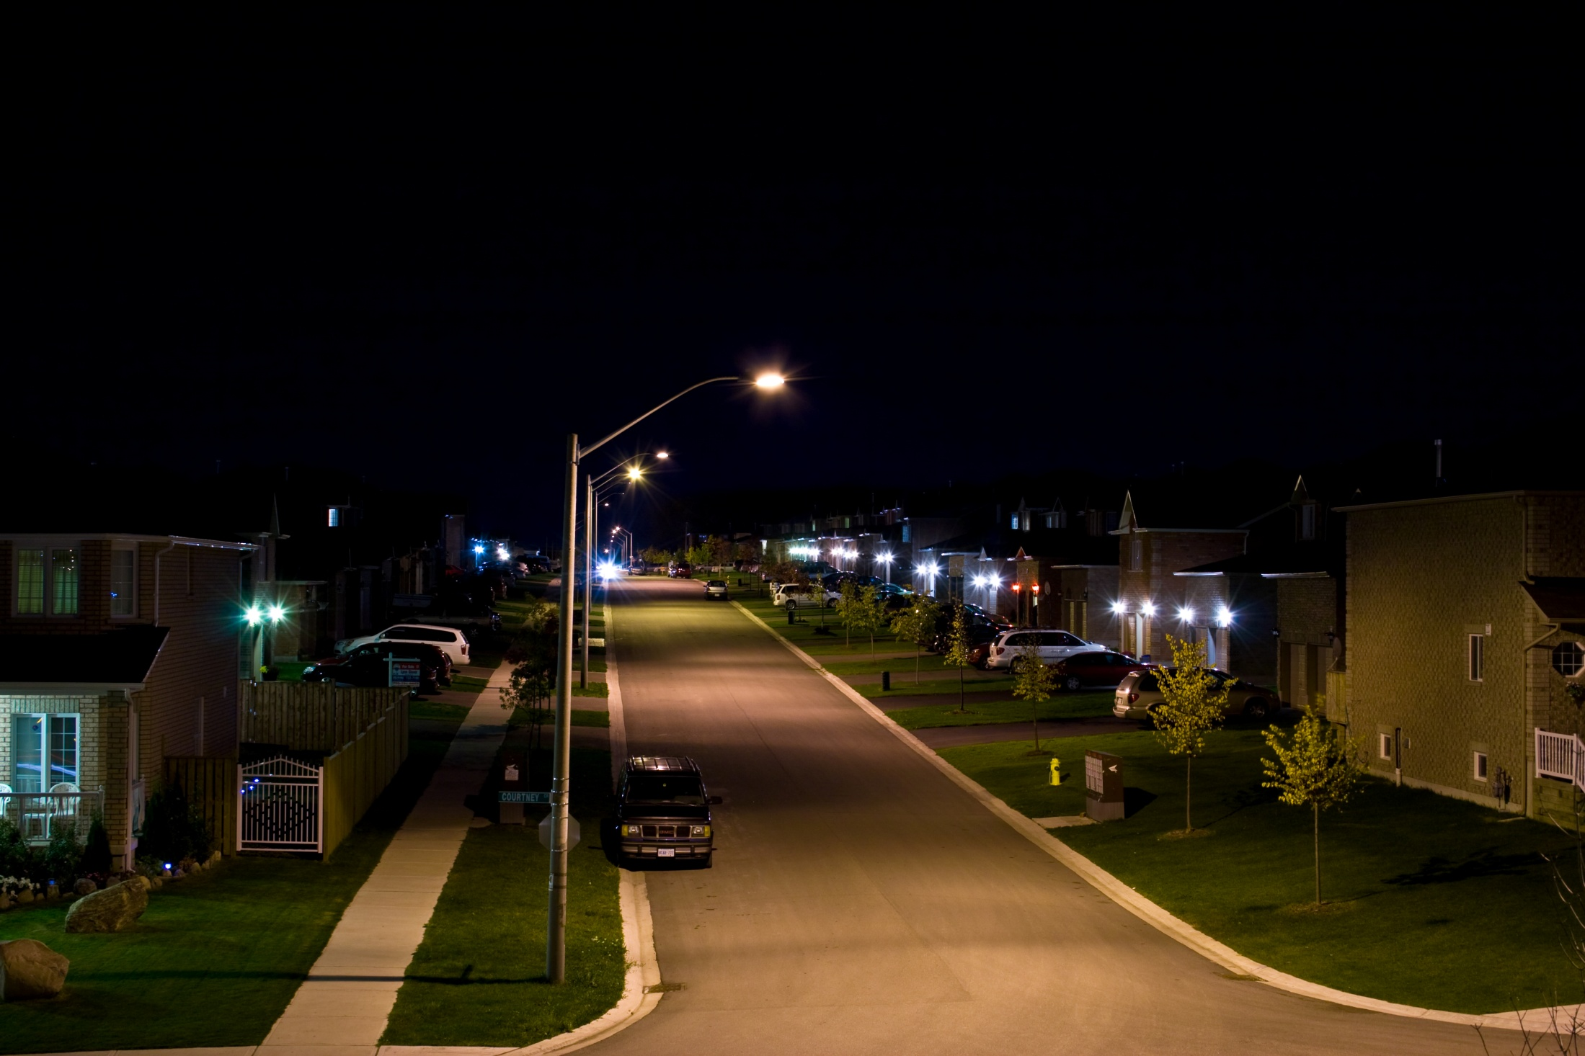
F/8 25 sec ISO 100

Slide 43

F/8 1/2000 sec ISO 400

Slide 44

F/8 1/1000 sec ISO 320

Slide 45









Continuous Shooting

Slide 46

F/8 1/3200 sec ISO 320

Slide 47




Continuous Shooting
>>
Not Available in Auto Mode

Slide 48



Continuous Shooting
Taking 10 photos gives a much higher chance that one will turn out clear

Slide 49

ISO Sensitivity
Similar to film ISO ratings
Higher number = higher sensitivity
= more noise (grain)
Usual range is 100-1600

Slide 50

F/10 1/60 sec ISO 800

Slide 51

F/10 1/125 sec ISO 1600

Slide 52

F/10 1/250 sec ISO 3200

Slide 53

F/10 1/500 sec ISO 6400

Slide 54

F/10 1/1000 sec ISO 12800

Slide 55

F/10 1/2000 sec ISO 25600

Slide 56
F/10 1/60 sec ISO 800

Slide 57

F/4 1/60 sec ISO 25,600

Slide 58

F/4 1/60 sec ISO 25,600

Slide 59

F/4 1/60 sec ISO 3200

Slide 60

F/4 1/60 sec ISO 3200

Slide 61

F/4 1/4 sec ISO 1600

Slide 62

F/4 1/4 sec ISO 1600

Slide 63
F/4 1/60 sec ISO 3200

Slide 64
F/4 1/60 sec ISO 25,600

Slide 65
Learning Through Examples
All images contain “EXIF data”
  All camera settings used
  Copyright info
  Keywords
  GPS location data

Slide 66

Reading your own EXIF data
Windows Explorer (Vista)

Slide 67
Reading EXIF data from images on the web
Mozilla FireFox Plugin:
  Exif Viewer:
    https://addons.mozilla.org/en-US/firefox/addon/3905

Slide 68

Exif Viewer

Slide 69


F/6.3 1/125 sec ISO 400

Slide 70

Geotagging your photos

Slide 71


Slide 72


GPS Information
F/5 ISO 400 1/1600 sec.

Slide 73
Trinity of Exposure
ISO
Av S or Tv

